Slide 1



European Green Fast Lanes
Roll-out Plan Wave 2
July 2017

Slide 2
Contents
The EGFL programme
  Introduction
  Scope
  Objectives
Roll-out plan
  High-level roll-out plan
  Detailed roll-out plan
3. Appendix

Slide 3
Introduction
The EGFL programme is based on five core themes
Trucking rationalization
Rationalizing EU trucking schedules by considering actual transit times, GHA capabilities, potential for spread delivery and peak volumes at the hub
Acceptance procedures
Redesign of the cargo acceptance process at outstations: new procedures for handling late-show, no-show shipments, status messaging and rebooking
Weighing
Implementing a 100% weighing requirement of individual shipments at outstations; updating the air waybill accordingly
Compliance checker
Launching a compliance checker that verifies shipment documentation and proactively signals potential violations of customs requirements
Status updates
Providing status updates of shipments to customers, e.g. in case of Late-show

Slide 4
Scope (1/2)
EGFL focuses on the initial part of the flow of goods and information from shipper to consignee
Shipper
Forwarder
Outstation
Hub (AMS/CDG)
Outstation
Forwarder
Consignee

Slide 5
Scope (2/2)
IATA-led industry group CargoIQ has defined air cargo milestones, which the EGFL programme follows
Forwarder
Outstation
BKD
FWB
FOH
LAT
RCS
DEP
Hub (AMS/CDG)
ARR
RCF
DEP*
BKD = Capacity confirmed by carrier and Routemap generated
FWB = Freight Waybill (Electronic Air Waybill message) sent to carrier
LAT = Latest Acceptance Time
FOH = Freight On Hand message sent to forwarder upon warehouse receipt (message to Forwarder)
RCS = Cargo and documents received from shipper by GHA, 'Ready For Carriage‘ (message to Forwarder)
DEP = Departed at Outstation / Origin airport
ARR = Arrival at Hub
RCF = Cargo and Air Waybill have been received at final destination, ‘Ready for Carriage’
= General CargoIQ indicator
= EGFL Performance Milestone
*This KPI is also highly dependent on external (airside) factors and hence not a fully representative indicator of programme success

Slide 6
Objectives
The main objectives of EGFL are to increase reliability and efficiency
The EGFL programme aims to:
Increase reliability (higher flown-as-planned) and reduce total transit time in order to provide a superior customer offering
1
  Achieve cost savings and enable future volume growth under given capacity restrictions by reducing repair, rework, and peak workload levels at the hub as well as at outstations
2
  Increase aircraft load factor by effectively prioritizing cargo at the hub (‘hot’ or ‘not’). The focus is on optimizing flights rather than trucks.
3
  Enhance collaboration and information sharing throughout the supply chain
4
5
  Enable proactive customs handling and increase customs compliance

Slide 7
Contents
The EGFL programme
  Introduction
  Scope
  Objectives
Roll-out plan
  High-level roll-out plan
  Detailed roll-out plan
    General
    Swissport
3. Appendix

Slide 8
High-level roll-out plan
The roll-out per station can be divided into an initial onboarding stage, the actual roll-out and an ongoing communications and change stage
Go-Live
II.
Onboarding
III.
Roll-out
Monitoring points
I.
Communications & change
x w
6w
6w
6w
6w

Slide 9
High-level roll-out plan
Through the communications and change stream, continuous alignment of all stakeholders is warranted
I.
Communications & change
Internal
Create buy-in and alignment with Network Planning, Revenue Management and local AFKL Cargo representatives
Promote the benefits of the EGFL programme internally
Validate the new trucking schedule with Network Planning
Inform internal stakeholders about process changes after implementation of EGFL
Continuous monitoring after implementation
External
Create buy-in and alignment with customers, the GHA and truckers
Promote the benefits of the EGFL programme externally
Launch a customer newsletter to inform customers on EGFL and related changes
Conitnuous monitoring and alignment with the GHA and truckers
Monitor performance both during and after the 8-week implementation phase

Slide 10
High-level roll-out plan
During the onboarding phase, all stakeholders at the station are informed of the forthcoming implementation in order to drive buy-in and create alignment
II.
Onboarding
Set up key parameters
During the preparation phase of 4 weeks, the new trucking schedule is first reviewed and finalized. Then, the trucking schedule is loaded in the NP and GHA systems to be ready for Go-Live on Tuesday in Week 3. System setup should therefore be completed by the end of Friday in Week 1.
Implement core processes
Perform an assessment of day-to-day operations at the GHA in the current situation to assess the change impact to come. Also verify the potential for Direct Pick-ups from customers in the area around this station.
Supporting activities
Review the existing ‘paperwork’: both contracts with the GHA and truckers as well as the local conditions that apply for customers in the region. Align with relevant internal (i.e. CSO, Kay Account Managers, Procurement) and external stakeholders. Timely adapt these documents so that they are compatible with EGFL requirements before Go-Live.

Slide 11
High-level roll-out plan
During the roll-out phase, a station mini-assessment is conducted, the new processes are implemented and progress is monitored
III.
Roll-out
Implement core processes
After the trucking schedule is checked, validated and loaded into NP systems, the Go-Live will take place on Tuesday in Week 3. From this moment on, the new core acceptance processes related to EGFL should be carried out by the GHA as specified in the process descriptions
Implement ‘add-on’ processes
In addition to the core processes, several additional ‘add-on’ processes should be implemented, such as Selective Loading Rules, Weighing and Measuring, Direct Pick-up and the Compliance Checker. This does not necessarily have to happen immediately upon Go-Live, but can be done gradually during the weeks after.
Supporting activities
The performance improvements of the new operational trucking schedule and the acceptance processes should be measured, from the % of successful deliveries before LAT at the outstation to the % of Flown As Planned shipments leaving AMS (DEP AMS). If (quantified) performance falls behind expectations, corrective actions should be taken.

Slide 12
Detailed roll-out plan
The standard roll-out plan for each station distinguishes 5 clusters of activities stretching 8 weeks, which are preceded by 4 weeks of preparation
51
0
1
2
3
4
5
6
7
8
Activity
Week
Preparation (4 weeks)
1. Set up
key parameters
1.1 Create and review schedule
1.2 Implement new trucking schedule
2. Implement
core processes
2.1 Assess current acceptance process
2.2 Implement new acceptance processes
Test and resolve issues
3. Implement
‘add-on’ processes
Make preparations to enable start of weighing in week 5
3.1 Selective Loading Rules
3.2 Weighing
3.3 Compliance Checker
Test and resolve issues
4. Supporting
activities
4.1 Review local contract/SLA
4.2 Review local conditions
4.3 Set up KPI structure and monitor performance
Local
AFKL
visit
GHA
visit
GO-LIVE
Report-out
5. Communications
and change
5a. Ensure ongoing communication with local AFKL, Network Planning and RM
5b. Ensure ongoing communication with customers, GHA and Truckers
Preparation Phase
Weekly presence at outstation

Slide 13
Detailed roll-out plan
1.1 Review trucking schedule
1.1 Create and validate new trucking schedule
What and why?
Actions
Review and finalize the newly made trucking schedule to ensure that the schedule is ultimately viable
Create and validate the new truck schedule to verify its suitability and validate with GHA and local AFKL. This starts by defining feasible transit times (based on actual transit times), considering GHA opening hours, peaks of incoming cargo at the hub (mainly from 02:00 to 04:00 on Saturdays and Sundays) and reviewing the impact on blocks of connecting flights; have this discussion first with the FJ, and also with GHA, NP, local operations and CSO. Make sure that NP is aware of any changes (e.g. co-load options).
Use a single file with the same template on the Dropbox to enter the schedules. This makes the job easier for NP.
If multiple truckers are contracted: assign truckers to the trucking schedule (based on their current performance); which trucker is responsible for the booking trucks, and which for the others?
Ensure that, when NP starts using the schedule, it also contains relevant information on when (final) plannings have to be sent, and when FBL’s are sent. This enables NP to run a smooth process.
When making the schedule, find a balance between what the market wants and what is practical/economical. For example in FLR, we started with one booking truck too many, which is expensive as it was often not full.
LAT is typically three hours before DEP, but this may still change depending on local circumstances. Be sensitive to what the local context requires!
Take good notice of the current trucking schedule and the new trucking schedule, to identify how strong the change for the station will ultimately be

Slide 14
Detailed roll-out plan
1.2 Implement new trucking schedule
1.2 Implement new trucking schedule
What and why?
Actions
Coordinate the timely loading of the new trucking schedule into the systems (e.g. AFLS) to ensure that the schedule is operational on the Go-Live date
Schedule Go-Live on a suitable date. Tuesdays typically have low volumes, which allows you to have a smooth start towards peak volumes on Friday/Saturday. It also allows you to fly in on Monday and prepare. Other dates are also possible.
Notify Network Planning of the Go-Live date, and oversee that the validated trucking schedule is loaded into the systems of NP and the GHA, at least 10 days before Go-Live (i.e. end of Friday of week 1). During this 10-day transition period, NP works with both old and new schedules.
Involve BlueLink in the roll-out and inform of upcoming changes. Discuss with Patrick Voorbij.
10 days
Go-Live
Onboarding
Roll-out
It is critical that one, identical trucking schedule is loaded in the NP and GHA systems. Deviations between loaded schedules have earlier caused signficicant problems
After Go-Live, you will face resistance from local stakeholders or from AFKL commercial. This is a major pitfall and potential inhibitor to the success of the programme. Be prepared to identify these issues and deal with them. Seek support from e.g. Simon or the FJ’s.
Changes in the schedule after Go-Live are possible if the new situation requires it, but cannot happen too often as this will frustrate NP’s process.

Slide 15
Detailed roll-out plan
2.1 Assess current acceptance process and ensure preparations are made
2.1 Assess acceptance process ensure preparations are made
What and why?
Actions
Assess and map day-to-day challenges and behavior, available resources (personnel, equipment). This gives an idea of the intensity of the change required and allows you to take actions in preparation for Go-Live
Make (at least) two visits before Go-Live: one to discuss EGFL with local AFKL and the GHA and to validate the trucking schedule, and another to become familiar with the GHA operations. This can also be during one trip.
  1. Visit the GHA and discuss with the AFKL Operations manager to discuss the EGFL programme and the impact it has, and to validate the trucking schedule. Also discuss IT (reporting) capabilities (for deviation and LAT reports), local acceptance procedures and behavior, as well as off-the-record agreements and ways of working established locally.
  2. Visit the GHA to get familiar with the GHA operation, and make an assessment of physically available resources (e.g. scanners, calibrated scales for weighing) that are needed for EGFL. The aim is to eventually enable weighing of 100% of shipments. If GHA resources are insufficient, this may require contractual changes (see 4.1).
Before implementation in FRA, it often happened that late deliveries were still loaded on their original trucks, as these trucks would wait for the shipments to be loaded. This is wrong, as it rewards the wrong customer behavior (i.e. late deliveries are still accepted and ‘fixed’) while we improve our own non-quality (we have less time at the hub).
Also, a lot of Go-Show shipments were simply sent from FRA to AMS without a booking. This is also something that needs to change in the context of EGFL.
Link to:
4.1

Slide 16

Detailed roll-out plan
2.2 Implement new acceptance processes
2.2 Implement new acceptance processes
What and why?
Actions
Ensure that the EGFL acceptance processes are implemented and physically carried out as laid out in the process descriptions
At the GHA, oversee that Late-show, No-show, Go-show, Early-show and High-show processes are carried out correctly. This also entails that communication with e.g. NP, RM, CSO is well established, and that deviation reports are sent within 60 minutes after each truck departure. Refer to the EGFL process descriptions, flowcharts and GHA manual (Appendix). Checklist:
Forwarder arrival registration
Time registration in place (reporting)
Door management
Truckers informed about truck dock
Acceptance
All cargo is weighed, weighing receipts stored
Acceptance flows followed (see flowcharts, Appendix)
Documentation
RCS and FWB’ process followed correctly (see 3.2)
Customs
Role and impact mapped and integrated
After acceptance
Correct storage, build-up and planning
Interaction NP/Swissport
Line-truck ordering process in place
Pre-planning in place
GHA sends deviation reports to Network Planning
Line-haul driver process
Truck arrival reporting in place
Booking checks performed (ADR/COL/height/etc.)
Manifests / FFM Secure / DEP reporting in place
Departure registration (STM) in place
This step represents the actual, physical changes on the ground, starting directly after the Go-Live and system setup is finished (see 1.2).
Previous issues in this context (at FRA, CPH) have been a lack of available scanners
Another potential threat can be a lack of truck docks at the GHA, if volumes are high
Plan ahead regarding your visits to the station(s): which days are busy? When to fly there?
Good luck with declaring your expenses ☺

Slide 17


Detailed roll-out plan
3.1 Selective Loading Rules
3.1 Selective Loading Rules
What and why?
Actions
Oversee the adoption of Selective Loading Rules by the GHA, to ensure that ‘hot’ cargo is not mixed with ‘cold’ cargo, which will help the Hub operation
Ideally, achieve that 4 (or 3/2 if less cargo is available) build up locations (buffers) are set up per truck in advance (see Appendix). This allows the incoming freight to be distributed as it arrives. Another method to demonstrate the selective loading principle is to use colored Post-It stickers (e.g. Blue, Green, Yellow and Red). Looking at the booking list, you can stick these to different shipments based on their ‘temperature’ in terms of remaining connection time at the hub. This way, the GHA can build up the correct pallets easily (blue with blue on one pallet, green with green on another, etc.). Normally, Network Planning has been sending over final planning with which the pallets were being built.
If Selective Loading Rules are not followed, ‘hot’ cargo will be loaded next to ‘cold’ cargo, meaning extra work at the Hub as they need to break down multiple plates to get to the ‘hot stuff’. By applying the selective loading rules, pressure is relieved from the Hub.
Link to:
SLR

Slide 18
Detailed roll-out plan
3.2 Weighing
3.2 Weighing
What and why?
Actions
Realize the 100% weighing requirement of the EGFL programme, to improve insight in actual shipping volumes and to invoice actual weight to customers
Make clear to the GHA and local AFKL what the benefit of weighing is. It will avoid the CCA process (e.g. additional charges sent to the customer after the cargo has been transported for exceeding the booked weight) as the corrected weight will be directly invoiced to the customer.
Oversee that 100% of cargo is weighed by the GHA. This implies that the GHA must have the required equipment and practices in place (see 2.1 and 4.1).
Instruct the GHA to create and store weighing receipts of all cargo and ensure that this is adhered to. This helps to counter potential claims by customers after they receive a bill for additional weight shipped versus the booking.
Once the station is ready to start weighing, ensure that this station is switched on in KLM systems as ‘certified’. This enables them to update the FWB with actual weight data.
Ensure that, after weighing, the GHA updates the FWB’ with the actual weights.
Start informing the GHA early on in the process about the weighing requirement. This way, they are able to purchase scales if they don’t have these already, and start the actual weighing process in week 5.
Some stations may already weigh 100% of cargo, other stations only a percentage of all cargo, and yet other stations may not conduct weighing at all. All will have to move towards 100% weighing
Link to:
4.1
2.1

Slide 19
Detailed roll-out plan
3.3 Compliance Checker
3.3 Compliance Checker
What and why?
Actions
Implement the compliance checker, a software tool that checks the Air Waybills and verifies whether they meet the criteria set by customs authorities (e.g. PO box, address formats, commodities)
Login to the compliance checker via a regular internet browser: https://cbp-checker.digitalcargolabs.nl/. Username: cgn_user1 Password: 6uMf9^^#vc
Before FOH, view the compliance checker and scan for any irregularities
Within boundaries, adapt the FWB and FHL in case of irregularities, charge AWC (other charge)
Beyond boundaries, contact CSO to receive revised documents, before proceeding with RCS. If this is after truck departure, the shipment remains as FOH until new documents and a booking are available.
The URL does not work properly in Internet Explorer, use Chrome or Firefox
This is a new tool, and therefore a learning experience: We are looking for feedback from customers and GHA’s on the performance of the tool, so that we can make further improvements
Ultimately, we are seeking to integrate the compliance checker into the GHA’s own systems

Slide 20
Detailed roll-out plan
4.1 Assess and modify local contract/SLA
4.1 Review local contract/SLA
What and why?
Actions
Review the existing local contracts and SLA’s with GHA’s and truckers to identify whether these require changes for EGFL and, if so, implement these changes before Go-Live
Review the GHA contract and contact Willem van Roozendaal (Procurement) if changes are necessary. Focus specifically on the weighing procedures, requirement to send deviation reports, Go-Show reports and LAT reports, opening hours, feasibility of the contracted LAT (in minutes before DEP) and the acceptance processes described. Changing the contract is not always necessary.
Ensure that relevant contract changes if required are made at least 2 weeks before the scheduled Go-Live, to ensure a smooth transition
SLA
Link to:
2.1

Slide 21
Detailed roll-out plan
4.2 Engage CSO to review local conditions
4.2 Review local conditions
What and why?
Actions
Review the current local conditions for customers and (if necessary) ensure that these are updated in accordance with EGFL before the Go-Live
Look up the local conditions of the station/region on the AFKL Cargo website and review whether they meet the EGFL requirements. This includes a described LAT of 180 minutes before DEP, the new acceptance policy and fees for No-show, Low-show, High-show, different cargo buildup (loose rather than pre-built) and cancellations. Ensure that changes are made to the conditions if these deviate from the future EGFL situation.
See FRA local conditions for reference:
https://www.afklcargo.com/WW/en/common/about_us/local_conditions.jsp
If the LAT offset is changed, this should also be changed in the Traxon system (via Michael Totdenhaupt)
LC

Slide 22
Detailed roll-out plan
4.3 Set up KPI structure and monitoring
4.3 Set up KPI structure and monitor performance
What and why?
Actions
Ensure that daily and weekly performance data are captured from the GHA and CargoIQ to enable performance tracking. Use this in your weekly report to the GHA, local AFKL and truckers
Establish daily reporting of CargoIQ milestones (LAT, RCS, DEP at station; ARR, RCF, DEP at AMS) together with Performance Management (Bram Snel and/or Arend Feenstra). This has also been done for FRA, should be in the same format. Ensure that CargoIQ settings for customers are adjusted in one go, as these changes need to be accepted one by one by customers.
With the GHA, establish daily reporting of in-depth data (FOH/LAT, RCS and DEP) – the ‘LAT report’. This includes, on an individual shipment level, AWB numbers, booking trucks, flight numbers, truck arrival times at FRA, FOH times, departure times, among other items. This helps to identify performance gaps and, for example, allows you to see how early all cargo is delivered at the GHA by customers.
Each week starting 1 week before Go-Live, create a weekly performance report to share with the GHA, local AFKL, CSO and truckers. Follow the template used during roll-out Wave 1, containing an ABCD, performance overview, (see Appendix).
Focus on actual Flown As Planned (FAP) as this is what customers care about and pay for, however RCF is where EGFL has a direct impact.
Be careful to not share sensitive data with competitors in your weekly reports (e.g. 2 truckers serving the same station). In such a case, make 2 separate reports.

Slide 23
Detailed roll-out plan
5a. Ensure ongoing communication with local AFKL and Network Planning
5a. Ensure ongoing communication with local AFKL, Network Planning
What and why?
Actions
Ensure high-intensity inward communication and alignment with local AFKL units and Network Planning throughout the entire implementation phase
Before Go-Live: Discuss the new truck schedule with NP. Particularly in regards to changing truck numbers, truck times and any other planning information. This is necessary to allow for NP to verify whether the new schedule is actually workable, and for them to make the necessary system changes to be ready for Go-Live.
Before Go-Live, give an initial presentation to the local AFKL about the EGFL project, its success and the drivers thereof. Show the EGFL promotion video with Marcel de Nooijer. This can help improve local support.
Continuously align with local AFKL operations. This is to ensure that the roll-out approach does not conflict with local requirements.
IN
Strongest focus of the communication effort is on the first weeks up to the Go-Live. From week 3 onwards, this turns more into monitoring and corrective action.
The requirement to inform the Hub operations is limited; the new schedule and system should only make their life easier

Slide 24
Detailed roll-out plan
5b. Ensure ongoing communication with customers, GHA and truckers
5b. Ensure ongoing communication with customers, GHA and truckers
What and why?
Actions
Ensure high-intensity outward communication and alignment with customers, the GHA and truckers throughout the entire implementation phase
Together with CSO, launch a customer newsletter to inform customers about EGFL-related changes. This includes process changes (e.g. new LAT times, LAT ‘enforcement’), but you can also use this to explain the benefits of EGFL to customers to build support. Do not send this letter too far in advance (e.g. 2 weeks prior to launch). Team up with local AFKL for this.
Before Go-Live, give an initial presentation to the GHA about the FRA case, its success and the drivers thereof. Show the EGFL YouTube promotion video with Marcel de Nooijer. This can help improve local support.
After Go-Live, ensure you are present at the outstation weekly, until no longer necessary. Ensure that we keep well aligned with the GHA and that issues are escalated and resolved quickly.
Ensure solid performance monitoring after the initial 8 weeks to see whether implementation sticks. See 4.3.
OUT
Strongest focus of the communication effort is on the first weeks up to the Go-Live. From week 3 onwards, this turns more into physical presence at the GHA, monitoring and corrective action.
Swissport, Jan de Rijk and Kühne + Nagel are involved from the start as consortium partners. Other actors will require an even stronger communication and change effort.
As a general rule, relevant stakeholders should all be (thoroughly) informed before any process changes are implemented. Follow the communication triangle (see Appendix).
Link to:
4.3

Slide 25
Detailed roll-out plan (Swissport)
Swissport stations have an accelerated rollout, with 4 weeks of preparation and setup, followed by a roll-out of another 4 weeks.
51
0
1
2
3
4
5
6
Activity
Week
Preparation (2 weeks)
1. Set up
key parameters
1.1 Review schedule
1.2 Implement new trucking schedule
2. Implement
core processes
2.1 Assess current acceptance process
2.2 Implement new acceptance processes
3. Implement
‘add-on’ processes
Make preparations to enable start of weighing in week 5
3.1 Selective Loading Rules
3.2 Weighing
3.3 Compliance Checker
4. Supporting
activities
4.1 Review local contract/SLA
4.2 Review local conditions
4.3 Set up KPI structure and monitor performance
Onboarding
meeting
GO-LIVE
Report-out
5. Communications
and change
5a. Ensure ongoing communication with local AFKL, Network Planning and RM
5b. Ensure ongoing communication with customers, GHA and Truckers
Preparation and setup
Weekly presence at station

Slide 26
Appendix
Stakeholder overview

Slide 27
Stakeholder list
Stakeholder
Class
Involvement
Potential for resistance
Network Planning (NP)
Manage closely
Internal
Network Planning ensures that trucks are booked/cancelled relative to the truck schedule, and monitor the trucking process throughout Europe
GHA’s
Manage closely
External
GHA’s carry out the main tasks related to accepting cargo from customers on behalf of KLM Cargo, and loading the trucks to be sent to the hubs (AMS/CDG)
Truckers
Manage closely
External
The trucker plays a key role in EGFL. The cargo planning relies on the truckers to stick to the given transit times, so that capacity at the hub is used effectively.
Customer Service Organization (CSO)
Manage closely
Internal
CSO is responsible for all communications towards the customer, including (re)bookings, no/go show follow-up and the design of local conditions
Revenue Management
Manage closely
Internal
Revenue management is responsible for authorizing (re)bookings through the use of RM software that determines whether certain freight is profitable or not
Local AFKL operations
Manage closely
Internal
Responsible for coordinating all local operational activities at the GHA in specific regions. Can be consulted (together with FJ’s) when issues with GHA arise
Customers
(shipper/forwarder)
Manage closely
External
Customers are required to deliver cargo to the GHA that matches the booking (weight, volume, timeliness, documentation), to enable a seamless shipment

Slide 28
Stakeholder list
Stakeholder
Class
Involvement
Potential for resistance
AFKL Cargo SteerCo
Manage closely
Internal
The SteerCo signs off on critical next steps or investment decisions
Procurement
Manage closely
Internal
In the EGFL context, Procurement must ensure that local contracts/SLA’s are adapted to suit the requirements of the EGFL programme to the greatest extent possible
Operations Development (FJ)
Manage closely
External
Responsible for managing the interface with truckers, GHA and CSO. Important stakeholder, can be consulted when critical issues related to these parties arise
Topsector Logistiek
Minimal effort
External
Partially funds EGFL through the NLIP, for which several workpackages were defined with distinct deliverables related to the Phase 1 and FRA POC
Cargonaut
Keep informed
External
Cargonaut is a software platform that ensures information exchange between private and governmental (e.g. customs) players at Schiphol airport
Customs authorities
Keep satisfied
External
Customs authorities are involved in the Cargonaut platform, and require a steady flow of information to ensure that cargo meets quality and safety standards
Competitors
Minimal effort
External
No strong involvement, aside from competitors potentially occupying floor space at the GHA’s
N/A

Slide 29
Stakeholder map
Internal
AFKL Cargo SteerCo
Procurement
Revenue Management
Local AFKL operations
Customer Service Organization (CSO)
Operations Development (FJ)
Network Planning (NP)
Project
Low involvement
Cargonaut
GHA’s
High
involvement
Topsector Logistiek
Truckers
Customers
Customs authorities
Competitors
External
= Potential for resistance

Slide 30
Stakeholder communication strategy
+
Customers
Customer Service Organization (CSO)
Buy-In stages
Internalisation
(Our way)
Support /
Engagement
Revenue Management
GHA’s
Institutionalisation
(The rules)
Local AFKL operations
Truckers
Degree of Commitment
Adoption
(The new rules)
Network Planning (NP)
Accept
Positive perception
(Testing)
Understanding
(Message understood)
Understand
Contact
(Message sent)
Awareness
(Message received)
–
Informed
    Elapsed Time throughout Change

Slide 31
Appendix
Process descriptions

Slide 32
RACI
Roles and responsibilities for GHA operations
GHA operations
A
GHA Supplier
Roles
Process
GHA Staff Warehouse
GHA Staff Office
Customer
CSO
Customs
NP
AFKL Systems
1
Unload truck, issue FOH
R
I
A
I
2
Physical Ready for Carriage check
R
I
I
Accountable
Responsible
Consulted
Informed
A
A
3
Documentation check and issue RCS
R
C
I
R
A
C
R
4
In case of RCS failure (unhappy flow): identify problem and report to CSO
A
I
I
Related to individual shipments
5
After RCS: buildup cargo for transport and consult NP in case info misses
R
C
A
6
Prepare shipping documents (customs, T1, manifests)
R
I
I
A
R
7
Load (follow selective loading rules) and seal truck
A
I
8
Send deviation report (to NP) and FFM (to CSO and NP)
R
I
I
A
9
Confirm DEP in Cargoal
R
I
A
Related to AFKL contracted trucker
R
I
10
Enter arrival & departure time of loading truck (AFKL trucker)
A

Slide 33
RACI
Roles and responsibilities for CSO operations
CSO operations
A
AFKL Cargo Market Manager
Roles
Process
CSO Office
Customer
GHA
NP
RM
AFKL Systems
1
Process booking
R
C
I
A
R
C
Accountable
Responsible
Consulted
Informed
2
Ensure shipment matches booking by proactively contacting the customer
A
A
R
R
3
Process irregularities on shipment level
A
C
I
I
I
C
R
4
Respond to irregularities and contact customer, notify on next steps
A
C
I
R
5
Process deviation report from GHA
A
C
6
Consult with customer on deviations and take action (rebooking)
R
C
A

Slide 34
RACI
Roles and responsibilities for Trucking operations
Trucking operations
A
Trucking supplier
Roles
Process
Trucker Office
Truck driver
GHA
Customs
NP
Document-ation
AFKL Systems
1
Receive and process trucking order as sent by AFKL NP
R
C
A
2
Dispatch truck to loading point
A
R
Accountable
Responsible
Consulted
Informed
A
3
Report arrival
I
R
I
R
A
C
4
Load truck according to safety standards
A
R
I
5
Collect documents and depart
R
R
I
A
6
Report departure
I
R
I
A
7
Drive to Hub and keep office + AFKL updated on journey progress
I
R
I
I
A
8
Report arrival at Hub
I
R
I
A
9
Visit Documentation to transfer documents
R
I
A
R
I
C
10
Unload after receiving confirmation from Documentation
A

Slide 35
RACI
Roles and responsibilities for Network Planning
Network Planning
A
Director Cargo Control Center
Roles
Process
NP
CSO
Trucker
GHA
Flight Planner
AFKL System
1
Monitor booking list
R
C
C
A
R
Accountable
Responsible
Consulted
Informed
2
Make truck orders/cancellations vs schedule
A
C
C
I
A
R
R
3
Process deviation reports and inform CSO
A
I
C
R
4
Monitor arrival at Hub
A
C
I
R
5
In case of arrival issues, contact the trucker for updates
A
C
R
6
Update flight planner based on new trucking information
A
I
7
Clean up booking list, consult with GHA in case of issues
R
C
A

Slide 36
Appendix
Contact list

Slide 37
Contact list
Content | Contact | Unit | E-mail
Station coordination | Sanja Mravik Duncan Tol Marco van den Berg Kenneth Fong | Operations Development (FJ) | Sanja.mravik@klmcargo.com Duncan.Tol@klmcargo.com Marco-van-den.Berg@klmcargo.com Kenneth.Fong@klmcargo.com
Contracts / supplier issues | Willem van Roozendaal | Procurement | willem.roozendaal@klmcargo.com
Local conditions / bookings | Local CSO | CSO | local
IT systems | Fred Timmers / Wilbert Akkermans | EGFL Project Team | fred.timmers@klmcargo.com / wilbert.akkermans@klmcargo.com
Truck planning | Network Planners | Network Planning | SPLCP.1@klmcargo.com – Nordics and eastern Europe SPLCP.2@klmcargo.com – Germany SPLCP.3@klmcargo.com – Italy and Switzerland SPLCP.6@klmcargo.com – UK/IE and Benelux
Escalation | Simon Spoor | EGFL Project Team | simon.spoor@klmcargo.com

Slide 38
Communication
Suppliers
(GHA / RFS)
Local AFKL
(ops / commercial)
Hub
(NP / RM)
Ultimately responsible, therefore needs to be able to influence decision-making
Informs customers!
Include and make adaptions to the local situation if these surface from the discussion with the ‘triangle’

Slide 39
Appendix
Selective Loading Rules - explanation

Slide 40

Selective Loading Rules
6
7
5-10
21
13
11-15
13
17
15
11
26
11
7
21
16-25
6
15
33
23
23
17
26
33
26+
Incoming freight
Truck positions
CT
On truck
Grouping of cargo on plates with similar connection times at the Hub.

Slide 41
Appendix
Station maps

Slide 42
Station map
EU trucking stations AFKL
AMS
CDG
= EGFL station

Slide 43
Station map
EU trucking stations KL
AMS
CDG
= EGFL station

Slide 44
Appendix
X-Show varieties

Slide 45
Acceptance varieties
No-show
Shipment is not there at DEP
Go-show
Shipment arrives without a booking
High-show
Shipment exceeds booked volume or weight
Early-show
Shipment arrives exceedingly early, taking up storage capacity
Late-show
Shipment arrives after LAT, but before DEP

Slide 46
Appendix
GHA Visit Manual and Checklist

Slide 47


European Green Fast Lanes
GHA Go-Live Visit Manual

Slide 48
Handleiding stationsbezoek
Aandachtspunten: waar let je op?
Wekelijks rapport
Communicatielijnen: wie vertelt wat aan wie, en wanneer?
GHA Information package

Slide 49
GHA Go-Live Visit
Aandachtspunten
Go-Live visit (~5 dagen)
Vooraf:
Vluchten regelen, hotel regelen, schoenen regelen, pasje regelen
Ga langs het NP blok verantwoordelijk voor jouw station om kennis te maken, noteer telefoonnummers.
Agenda maken voor stations bezoek
Communiceer aanwezigheid op station in de planner, geef vluchten en hotelboekingen door in schema (tab 2 in de Planner)
Tijdens:
Participeren in de operatie, eigenaarschap nemen van station. Eerste prioriteit is het tijdig vertrek van de truck. En géén RCS geven totdat vracht daadwerkelijk goed bevonden is.
Registreren wat er gebeurt: Hoe wordt vracht aangeleverd en geaccepteerd? Wat gebeurt er als vracht te laat is? Hoe worden trucks geregistreerd? Hoe is het contact met NP? Komen de bestelde trucks op tijd (palletized 1 uur vóór DEP, Loose 2 uur vóór DEP, zie ok CPWorkflow)? Wordt de FBL op tijd ontvangen (~5 uur vóór DEP)? Wordt de final planning op tijd ontvangen? Worden de FWB’s goed ontvangen vanuit de klanten via KLM (Klant → KLM → GHA)? Hoe gaat men om met versturen van berichten? Updaten FWB (FWB’)? Wordt er gewogen? Worden weegbonnen gemaakt en bewaard? Hoe? Maak notities.
Communiceren: Leg aan de mensen op de vloer bij de GHA uit waar we mee bezig zijn, en waarom (je kunt hier het GHA info pakketje voor gebruiken, zie DB). Gaat er iets niet volgens plan (truckers te laat, klanten te laat?) → escalatie naar FJ’s en zorgen dat er snel actie + resultaat komt. Overleg ook als interns onder elkaar / help elkaar.
Rapporteren: Dagelijks feedback naar Simon/Vincent over voortgang. Op welke punten moet het plan aangepast worden?
Plan maken: Maak met de GHA een plan voor de volgende stappen (per wanneer 100% wegen? Wat is er hiervoor nodig?)
Na:
Rapportage maken van bezoek o.b.v. wat je gezien hebt en je notities, gebruik template
Bijhouden voortgangstracker, met notities waar nodig. Markeer issues.

Slide 50
Handleiding stationsbezoek
Aandachtspunten: waar let je op?
Wekelijks rapport
Communicatielijnen: wie vertelt wat aan wie, en wanneer?
GHA Information package

Slide 51
STATION - ABCD
Status Stream | Overall process:*
Achievements |  |  | Benefits
Concerns |  |  | Do next

Slide 52
GHA Go-Live Visit
Daily report (1)
1
2
3
Late-Shows
No-Shows
Trucks arriving late
AWB # | Customer | Total KG’s
AWB # | Customer | Total KG’s
Truck number | Trucking company | # minutes late
4
Trucks departing late
Truck number | # minutes late | Cause

Slide 53
GHA Go-Live Visit
Daily report (2)
5
6
7
Are FBL’s received on time? If not, action taken to repair?
Final planning received from NP on time? If not, action taken to repair?
Have deviation reports been sent to NP? If not, why? Any repair action?
Yes / No
Yes / No
Yes / No
8
9
10
Is the RCS check and RCS messaging carried out correctly? How?
Are FWB’s received correctly from customers (via KLM)?
If applicable: Are weighing + FWB’ processes carried out correctly?
Yes / No
Yes / No
Yes / No

Slide 54
GHA Go-Live Visit
Daily report (3)
11
Other notes/remarks

Slide 55
Handleiding stationsbezoek
Aandachtspunten: waar let je op?
Wekelijks rapport
Communicatielijnen: wie vertelt wat aan wie, en wanneer?
GHA Information package

Slide 56
GHA Go-Live Visit
Principles
The truck leaves on time
Late is late: customers must deliver cargo on time. Repair is possible, but should not endanger the timely departure of the truck. See Late-Show process.
If more than one truck is required given the volume, additional trucks are scheduled before the booking truck
Focus on timely messaging of FOH and RCS
RCS is only given after cargo is checked and approved. Late-Shows (beyond repair) and Go-Shows are not accepted (only get FOH), and require a new booking.
Apply selective loading of pallets by following the planning sent by Network Planning
100% of cargo is weighed, FWB is updated with new weights and store weighing receipts
Send deviation reports to Network Planning max. 1 hour after truck departure (following the template)
Send daily FAP reports to Network Planning (following the template)
Send overview of Go-Show shipments to CSO

Slide 57
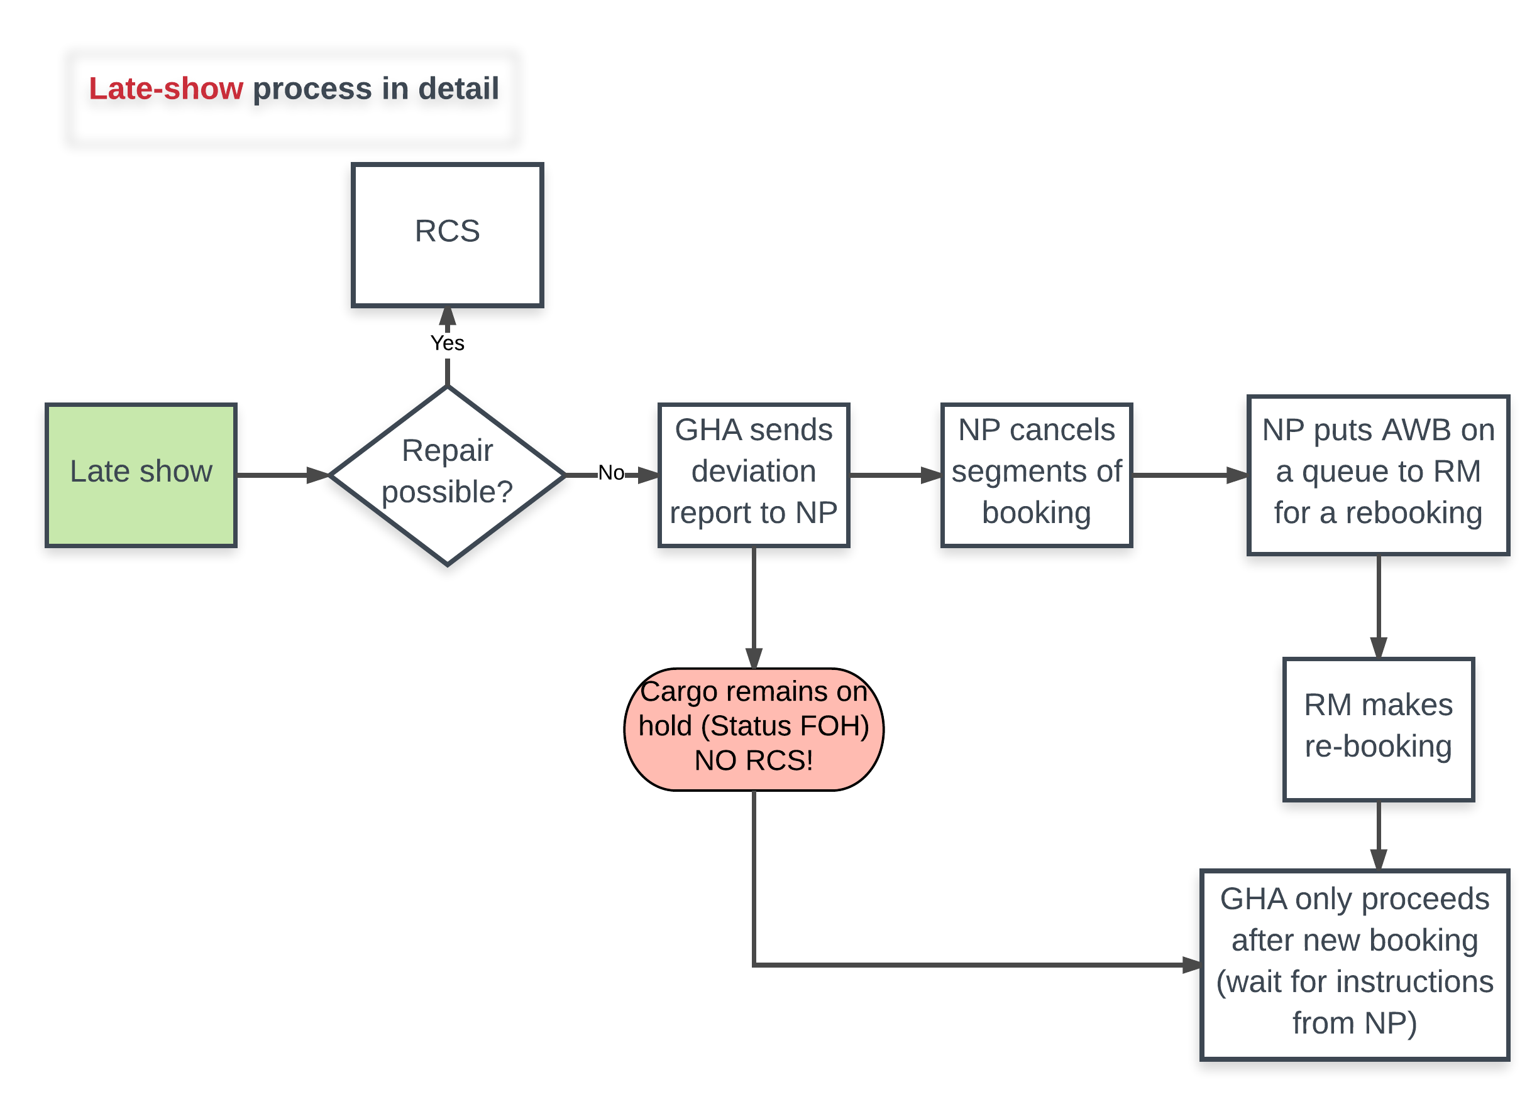
GHA Go-Live Visit
Communicatielijnen – Late-Show

Slide 58
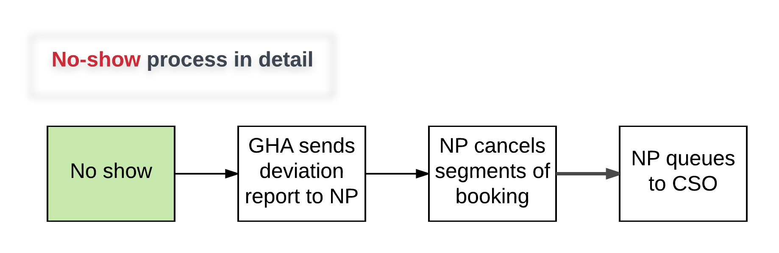
GHA Go-Live Visit
Communicatielijnen – No-Show

Slide 59
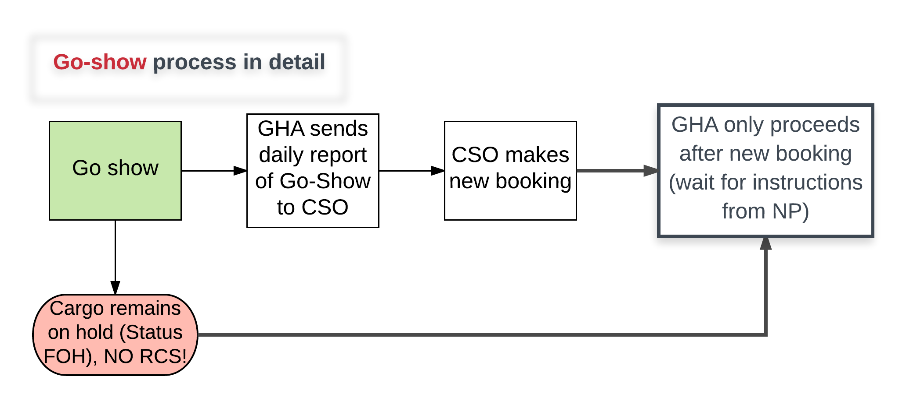
GHA Go-Live Visit
Communicatielijnen – Go-Show

Slide 60
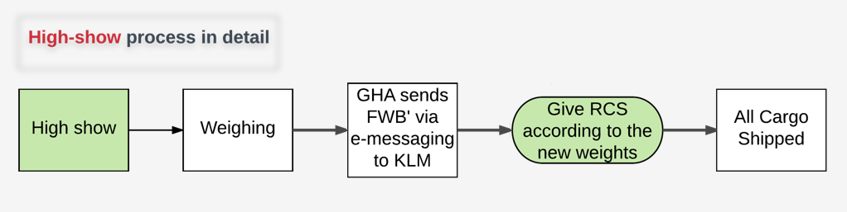
GHA Go-Live Visit
Communicatielijnen – High-Show

Slide 61
Handleiding stationsbezoek
Aandachtspunten: waar let je op?
Wekelijks rapport
Communicatielijnen: wie vertelt wat aan wie, en wanneer?
GHA Information package

Slide 62



What are we doing?
European Green Fast Lane is an AF/KL project that aims to improve the quality of incoming cargo shipments out of Europe towards the Hubs (Schiphol and Charles de Gaulle)
As ‘Rubbish In = Rubbish Out’, we aimed to eliminate waste by redesigning the Acceptance process based on Lean principles such as ‘First Time Right’ and ‘Just In Time’
Simplified trucking schedules
‘Too late’
Clear acceptance rules
‘Too much’
Shipment status updates
‘Incorrect’
Customs and compliance checker

Slide 63







Why are we doing it?
To raise overall supply chain quality levels
To increase the reliability of our product
To increase the load factors of our aircraft
To shorten transit times
To ensure faster and easier customs handling
To enable a ‘lean’ hub operation

Slide 64

How are we doing it?
The project started with an Operational Proof of Concept for KL only, on the (biggest and most complicated) tradelane FRA-AMS. The process was adapted step by step:
Partnerships to optimize total chain performance and increase FAP
Latest Acceptance Time adjusted to capabilities of the GHA
Trucking schedule rationalised and evenly spread over the day
Weighing increased to 100% and FWB’ implemented
Ready for Carriage checks formalized and RCS processes corrected
The rest of the EU stations will follow in a phased roll-out, starting May 2017
Compliance checks for FWB and FHL implemented
Reporting mechanisms set up as feedback to customers and GHA

Slide 65
What does this mean for you?
Bigger spread of delivery times that will significantly reduce queueing
Peak reduction in the delivery process to enable flight optimization rather than truck optimization
After RCS is given, AF/KL will commit to a promise that it can keep
Late-show shipments are rebooked at first available capacity before cargo is further transported
High-show is accepted, but FWB is adjusted and the invoice will be based on actual weight
High-Show will keep priority within tolerance levels; otherwise, priority will be lowered
Targeted feedback on LAT (No-show / Late-show) and FWB/FHL compliance errors

Slide 66
What needs to be in place?
Approve the new trucking schedule and create awareness of the changed truck schedule
Ability to send FOH and RCS status messages to Cargoal when cargo is received and accepted, respectively
Ability to create and send an adjusted air waybill (FWB’) when adjustments need to be made after weighing
Enforce new acceptance process, including strict adherence to LAT and following the ‘silver rule’. See the new process
Adhere to the cargo plannings (selective loading rules) sent by AFKL Cargo Network Planning
Send deviation reports for each truck to AFKL Cargo Network Planning after truck departure. Use the template.
Send daily FAP reports to AFKL Cargo that specify No-Show, Go-Show, High-Show shipments. Use the template.
Ensure 100% weighing of cargo and ensure that the weighing receipts are kept
Have door management and forwarder arrival + departure time registration and reporting in place

Slide 67
